Slide 1
Flu Shot Predictor
Akash Memon – 14884
Hammad Ahmed – 14963
Junaid Jabbar - 14816

Slide 2
Problem Statement
It is estimated that 250-500K people die of seasonal flu annually and 3-5M people are severely affected.
It is estimated that 280K deaths occurred during the 2009 Swine flu pandemic (caused by h1n1 influenza virus).
The deaths can be avoided if people get flu shots every year.
Our project aims at determining the likelihood of an individual of getting flu shots based on certain factors using binary classification algorithm.
This information could be useful for government or other health authorities to plan their campaign to encourage people to get flu shots.

Slide 3
Approach

Slide 4
Strategy
We used Python Machine Learning to predict the h1n1 and seasonal vaccine classes in the Flu Vaccine Dataset using Random Forest Classifier.
We also applied some pre-processing techniques to make data more clean and friendly for the hardware to process and get more accuracy and information from the data.
We partitioned the provided data into training and testing dataset, trained our model and predicted the outcome.

Slide 5
Dataset
The dataset was acquired from the 2009 National Flu survey. It is available on the internet for different analysts to observe.
The dataset contains approximately 30K rows and 36 columns. The dataset size might vary if pre-processing techniques are applied such as creating dummy variables or by dropping some columns.

Slide 6
Pre-processing of Data

Slide 7
Label Encoding
The first step was to do processing on the categorical columns to convert them into their numerical representation(preferably binary).
There are many techniques in Python libraries that you can implement such as OneHotEncoding and Label Encoder.
We used the pandas getdummies() to create dummy columns for each unique categorical entry in the column, it is necessary to keep n-1 dummy columns in your data frame to avoid Dummy Trap.
Example on next slide…

Slide 8
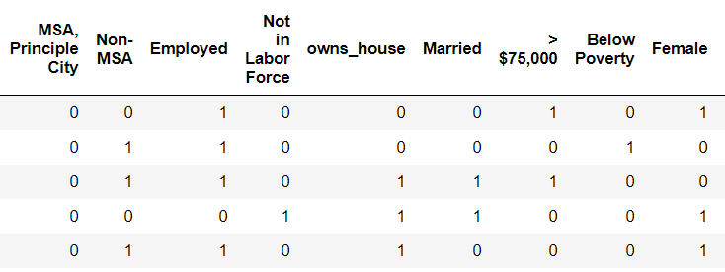

Slide 9
Handle Missing Values

Slide 10
Replace NaN Values
Every real world data will not be perfect, and the flu vaccine data set had close to 6000 Nan values that needed to be filled in for the model to work properly.
We used multiple techniques and tried different values like mean, median, 0 to get the desired accuracy and score.
The median value of each column provided the best overall accuracy and prediction score.

Slide 11
Random Forest Classifier

Slide 12
Model Training
After pre-processing and handling the missing values, it was time to train the model.
First the data needs to be split into training and testing data, we kept the ratio of training to testing at 0.33.
We trained the model separately for each h1n1 and seasonal class prediction columns.
We tried different classifier attributes such as max_depth, random_state, and n_estimators etc.
In the end we predicted the class labels using the test features data provided by the challenge.
The running time of the algorithm is O(v * nlog(n)), where n is the number of records and v is the number of attributes.

Slide 13
Visualization

Slide 14
Power BI
After predicting the probabilities, we experimented on some visual tools like Tableau and Power BI and latter was more suitable for our task.
We used different visuals to observe and interpret the behavior of respondents based on their ethnicity, age, race and income etc..
Below is the link to the Power BI dashboard where the generated report is published.
https://app.powerbi.com/groups/me/reports/4af97662-2d59-4030-8e2d-614e8ce64008/ReportSection

Slide 15
Thank You!

